Slide 1
Lecture 1
Platform 0: wires and switches
Computing platforms, semester 2
Novosibirsk State University
University of Hertfordshire
D. Irtegov, A.Shafarenko
2019

Slide 2
Base of all digital platforms
Discrete signals
  Mechanical
  Electrical
  Optical
  Chemical
  etc
Switches (devices that give discrete reactions to signals)
  Depend on the nature of the signal
  Humans achieved best results building electrical (electronic) switches, so we concentrate on them

Slide 3
Mechanical switches
Known from prehistoric times (e.q. animal traps)
Were used to build pretty complex mechanical automata

Slide 4
Interesting mechanical discrete devices
Jackuard loom (1804)
A programmable loom that can be used to weave fabric with pictures
(carpets, tapestry, brockade)
Medieval Chinese brockade
(manually woven)
Punch card program
for Jackuard loom

Slide 5
Mechanical arithmometers

Slide 6
Babbage Difference engine
Mechanical device used to calculate polynomial functions
Built by Charles Babbage in 1819-1822
Successor, the Analytical engine, was designed as a punch-card programmable universal computer
Never built, but inspired Zuze Z1 and Harvard Mark I/II in next century

Slide 7
Electromechanical devices
Hollerith census tabulator
Device to calculate statistical functions using raw data on punch cards
First used to process data of 1880 US population census
Hollerith company now is known as IBM
Later, more sophisticated programmable tabulators were built

Slide 8
Automatic telephone exchange (single node)

Slide 9
Automated telephone exchange
(whole machine)
Devices like this were used to route phone calls through most of XX century
First machines of this kind appeared in 1920s
Last units in Russia went out of service in 2010s
https://www.ridus.ru/news/16079

Slide 10
First successful programmable computer
IBM ASSC aka Harvard Mark I. Delivered to Harvard in 1941
Built using electromechanical switches (relays)
Used punched cards for input/output
And punched paper tape for program

Slide 11
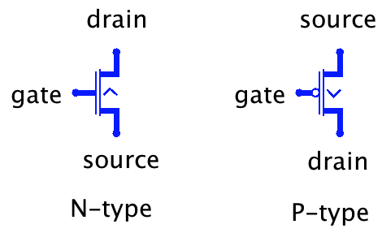
Modern electronic switches
The field effect transistor
A semiconductor device
Pretty interesting physics
Bardeen, Brattain, and
Shockley got a Nobel prize
for inventing it
Actually, it is an amplifier
The higher a gate voltage
the stronger current can pass between source and drain

Slide 12
Why transistors?
First fully-electronic computer was build using vacuum tubes, but they proved expensive and unreliable
We learned to make transistors cheap, so we can economically build devices containing millions and billions of them
We learned to make transistors reliable, so the devices with billions of them can work for years 24/7/365
We learned to make them small, so you can carry a device with billions of transistors in your pocket
We learned to make them fast, doing billions of switch operations per second (1GHz is a billion oscillations per second)
THz Ga-As transistors are available, but we cannot make them cheap and small.

Slide 13
More on transistors
In digital circuits, transistors are used as binary switches
One voltage opens the transistor fully
(its effective resistance close to zero)
Other voltage fully closes the transistor
(effective resistance close to infinity)
In N-type, high voltage opens and low voltage closes
In P-type, low voltage opens and high closes
In modern CMOS devices, N and P transistors are used in pairs
(thus the word Complementary in CMOS)

Slide 14
Transistors are imperfect
Real transistors do not react immediately on gate voltage
Transistors consume current on the gate, so you cannot feed too many gates from single source.
Resistance of open transistor is not zero, and resistance of closed one is not infinity
Signal propagates through the wire not instantly. Actually, even on MHz frequencies, a wire works as a waveguide.
We won’t go deep into this in our course
However, if you will build complex real devices, like 32-bit CPU, you will have to deal with all this

Slide 15
Building digital device with transistors
The device uses two voltage levels
  Vdd (above transistor drain), aka PWR aka logical 1
  Vss (below transistor source), aka GND aka logical 0
Theoretically, we can inverse the terminology and consider a high voltage 0 and low voltage 1. We would need to replace all N-transistors with P- and vice versa

Slide 16
NOT gate (logical invertor)

Slide 17
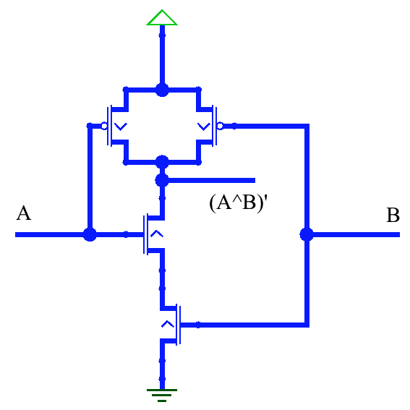
NAND gate
Output=Not(A and B)
(A^B)’ in Boolean notation
You can turn in into ”normal” AND
By adding invertor (Not gate)

Slide 18
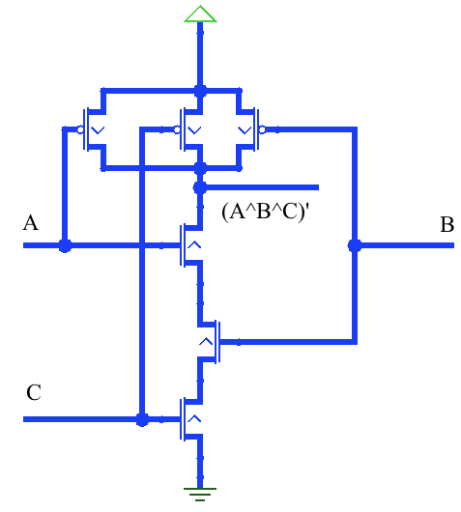
3-input NAND gate

Slide 19
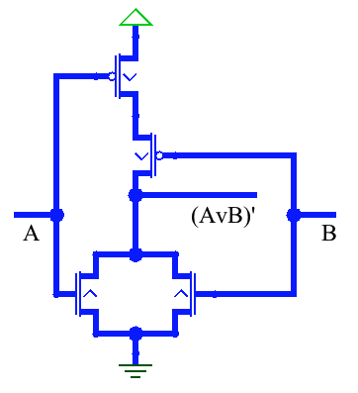
NOR gate
NAND gate turned upside down
From Boolean algebra, you should remember, that (AvB)’=(A’)^(B’)
Having AND, OR and NOT operations, we can implement any logical expression

Slide 20
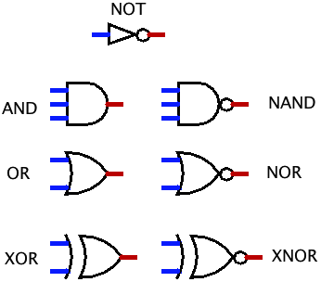
Gates symbols in Logisim

Slide 21
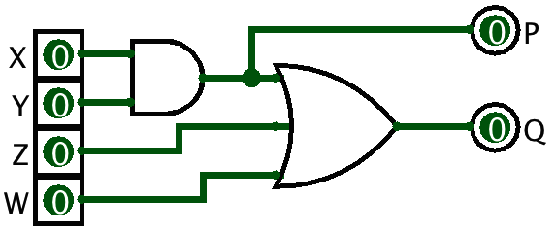
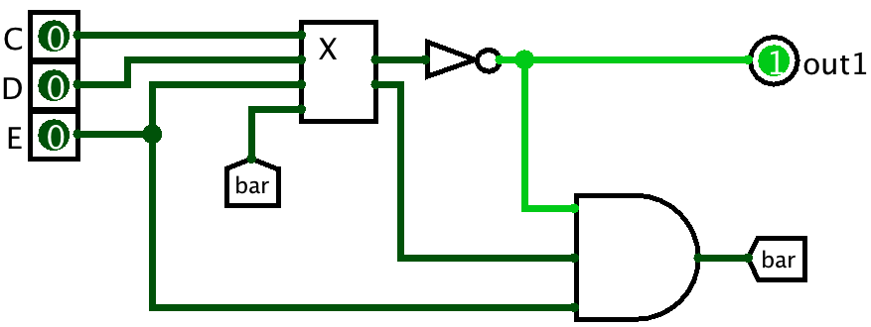
Logical schemes and chips in Logisim
Chip X
with inputs X, Y, Z, W
and outputs P, Q
Scheme utilizing chip X
And tunnel bar
Tunnel is a wire you do not want to route through scheme

